Slide 1
Energy Balance How to Stay on Track with Weight Goals
Rebecca Forrest, MS, RD, LD

Slide 2
How Body Uses Energy
Metabolism – the process by which the body breaks down substances & gets energy from food
Energy needed is determined by 2 things
Activity level
Basal Metabolism Rate (BMR): amount of energy needed to keep body functioning at rest
Energy Balance: amount of food energy taken in is equal to amount of energy used
E.B. Formula:
BMR+energy for activity (24hrs)+energy to digest food = Total energy body needs

Slide 3
Calculating Your Calorie Needs
1. Calculating BMR calories
Females
Body weight (pounds) x 10 = BMR calories
Males
Body weight (pounds) x 11 = BMR calories
2. Calculating Activity Level Calories
Activity level %BMR calories Multiply by
Inactive 30 .30
Average activity 50 .50
Very active 75 .75
3. Calculating Calories Needed To Digest Food
(BMR calories + activity calories) (0.1) = Digestion calories
4. Total calories needed = Step 1 + 2 + 3

Slide 4
Calculating Your Caloric Needs (Do for self)
Mr. Evanson as an example
Step 1
170 x 10 = 1700 (BMR calorie needs)
Step 2
1700 x 0.5 = 850 (Activity calorie needs)
Step 3
(1700+850) (0.1) = 255 (Digestion calorie needs)
Step 4
1700 + 850 + 255 = 2805

Slide 5
How to Determine Calorie Needs
Now that you have calorie needs there may need to be modifications based on weight goals.
Gain Weight:
Add 500 calories/day to gain 1 pound per week
Lose Weight:
Subtract 500 calories/day to lose 1 pound per week

Slide 6
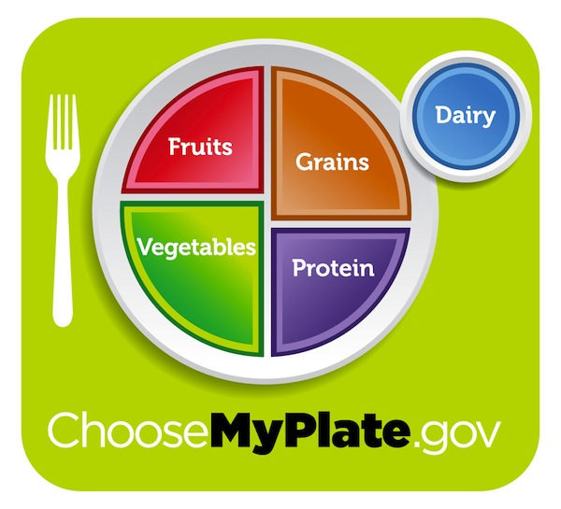
Make a Healthy Plate
Notes:
*MyPlate is great, but in this case, since we are controlling our calories, we will save our fruits(calories) for snack times.
*Or follow MyPlate three times a day with zero-to-one snack.

Slide 7
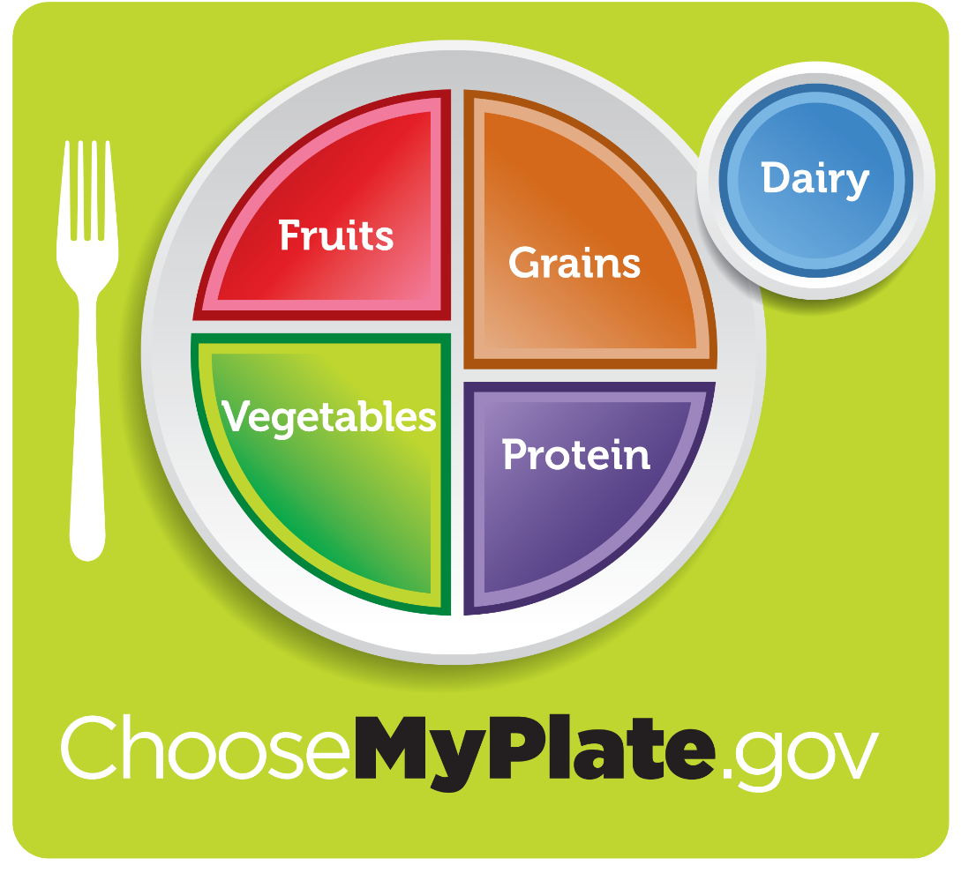
What is Healthy Eating?
Rely on “real foods,” not processed foods - with MyPlate!
Make half your grains, whole grains
Enjoy low-fat dairy foods 2-3 times daily
Eat plenty of fruits and vegetables
Enjoy lean meats in moderation
Include fish 2 times weekly
Notes:
* On a daily basis, most high school wrestlers
should be consuming 8 servings of grain products, 3 servings of vegetables, 3 servings of fruit,
2 servings of low-fat milk products, and 2 servings of lean meat - depending upon body size and
activity level.

Slide 8
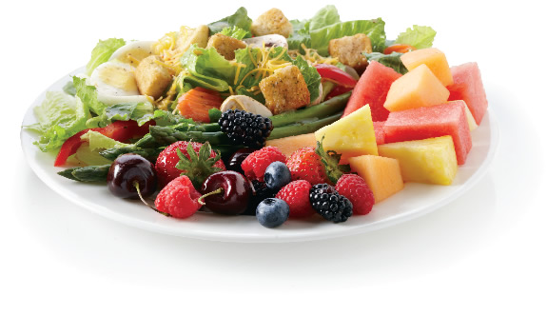
Carbohydrates
Body’s main source of energy
Provide the body with fiber, essential vitamins and minerals
*Complex carbohydrates are the best choice
Choose whole grains, fruits, vegetables and low-fat dairy
Notes:
Complex carbohydrates are high in starch and low in simple sugars.
*Note: Choosing complex carbohydrates and decreasing simple sugars is a great recipe for losing weight.

Slide 9
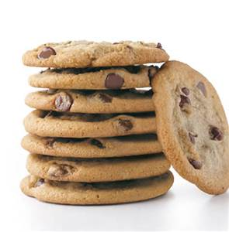
Simple Carbohydrates
Examples: Pop, candy, pastries, cookies etc.
Low or no essential vitamins and minerals
Provides short-term energy
Skip these or choose in moderation

Slide 10
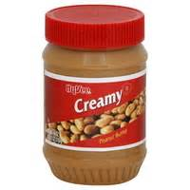
Fat
Essential to the human body (in moderation)
Provides long-term energy for the body
May be more difficult for the body to use for energy
Limit saturated fat
Olive oil, avocado, nuts, nut butters
and salad dressing
Notes:
*Protects vital organs
Limit - pizzas topped with meat, hamburgers, french

Slide 11
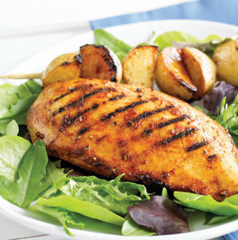
Protein
Good source of energy
Builds and repairs body tissues (muscles and organs)
Supports the immune system
Helps move vitamins & minerals
Beef, eggs, pork, fish, poultry, beans etc.

Slide 12
What to Eat?
Choose foods from all food groups
Think protein and fiber!
Protein and vegetable sources
Protein | Vegetable | Fruit | Grain | Other
3 oz. chicken breast | 2 cups leafy greens | ½ cup mandarin oranges | 1 whole-wheat roll | 2 tbsp. salad dressing
½ cup cooked black beans | 1 cup chopped lettuce - ½ cup chopped tomatoes | ½ frozen banana blended with ½ cup frozen berries | 1 whole-wheat tortilla | ½ medium avocado

Slide 13
Smart Snacks
Plan ahead for snack that includes protein and/or fiber
Try these simple smart snacks to pack!
+
Protein Source | Fiber Source
1 oz. cheese stick | 6-10 whole-grain crackers
½ cup edamame | 2 clementines
6 oz. Greek yogurt | 2/3 cup berries
1 oz. nuts | 1 small apple
1 tbsp. peanut butter | 1 slice whole-grain toast
Notes:
Planning ahead will help you stick to a healthy diet and eat well,
no matter where you are or how busy your schedule gets.

Slide 14
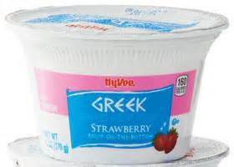
Breakfast
Eating breakfast may help decrease 200 calories a day or 24 pounds a year.
Include a good source of protein and fiber
+
Protein | Fiber & Antioxidants
1-2 eggs | Whole-grain toast & orange
1 cup nonfat Greek yogurt | 1/2 cup flax granola & 1 cup berries
Protein bar | Apple
Hot quinoa & oatmeal cereal with berries & nuts
Notes:
Eating breakfast helps keep off weight in the long run

Slide 15
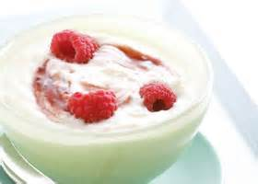
Eat Every Couple of Hours
Boosts metabolism
Prevents overconsumption of food
Choose healthy snacks
Think protein & fiber!
Helps obtain all necessary nutrients

Slide 16
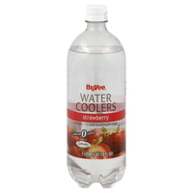
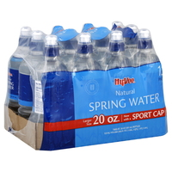
Are you Hungry or Thirsty?
DID YOU KNOW?
The hypothalamus controls both hunger and thirst, so it sends the same signal whether you are hungry or thirsty.
It might take up to 15 minutes for the hypothalamus to send a signal letting the body know thirst has been satisfied
Determine the difference between hungry and thirsty
Notes:
Try drinking a glass of water first before you get something to eat.

Slide 18
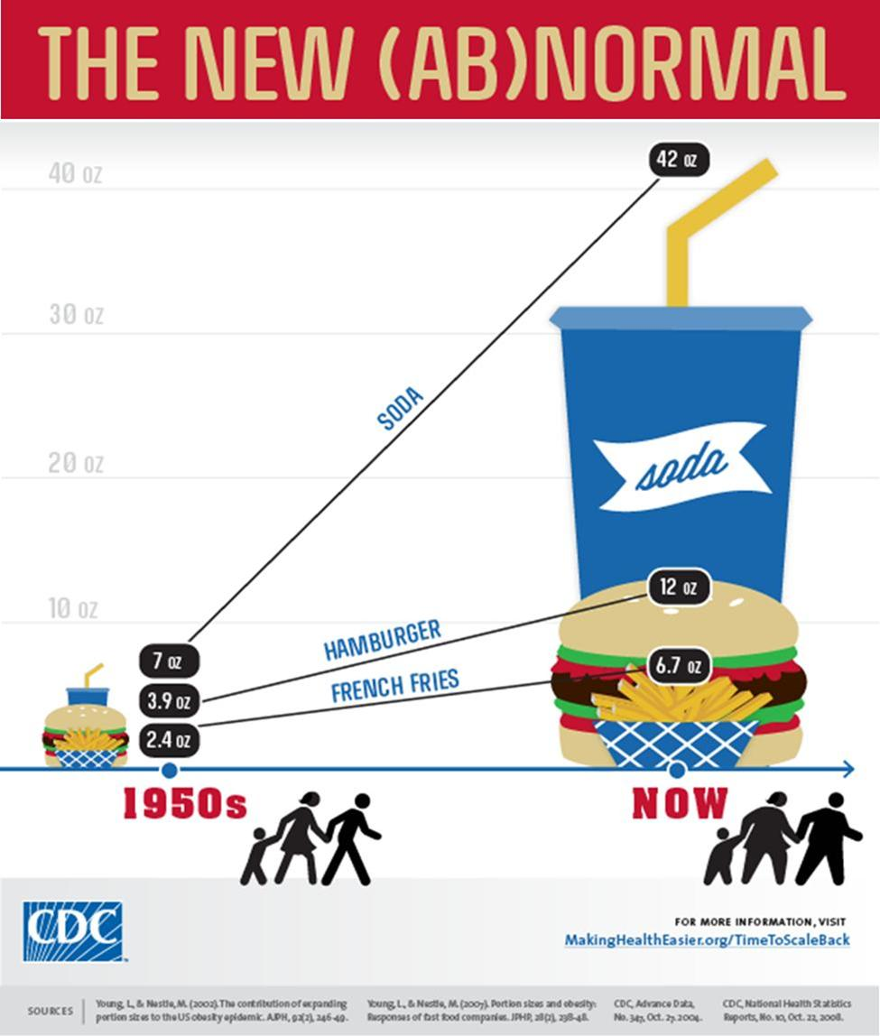
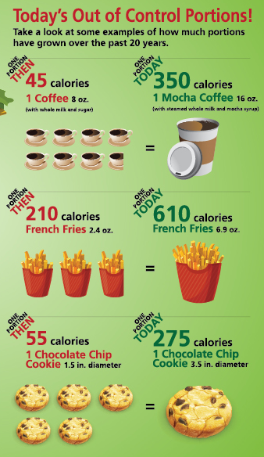
Size Matters
Source: www.prowellness.vmhost.psu.edu/portion-distortion

Slide 19
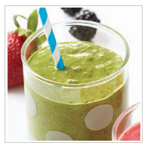
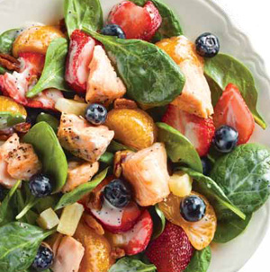
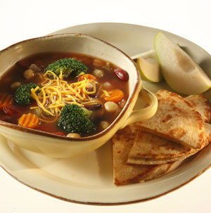
Putting It All Together
Breakfast
A.M. Snack
Lunch
Spinach Salad with Salmon & Berries
Herbed Omelet Wrap
Green Protein Smoothie
P.M. Snack
Dinner
Greek Yogurt & Berries
Fiesta Soup Meal
Notes:
*Make note how each meal/snack includes a good amount of protein and fiber! Filling, yet satisfying!
Herbed omelet wrap recipe - https://www.hy-vee.com/meal-solutions/recipes/Herbed-Omelet-Wraps-R8998.aspx
Meal calorie count is approximately 1,420 – considering Greek yogurt and berries are 200 calories
Breakfast – Herbed Omelet Wrap - http://www.hy-vee.com/meal-solutions/recipes/Herbed-Omelet-Wraps-R8998.aspx

Slide 20
Questions?
Thank You
Rebecca Forrest, MS, RD, LD
Liberty Hy-Vee Dietitian
816-792-3210
rforrest@hy-vee.com

